Slide 1
Style transfer
ITZIAR SAGASTIBERRI
MIREIA GARTZIA
CAROLINA FERNÁNDEZ-PEDRAZA
CRISTINA GONZÁLEZ

Slide 2
Index
Style transfer concept
Getting ready
Context of style transfer networks
Training phase
Testing phase
Conclusions
References

Slide 3
Style transfer concept
Style transfer is the technique of recomposing images in the style of other images.
Technique: optimization of a loss function in a CNN.

Slide 4




Getting ready
The code used can be found here: https://github.com/eridgd/AdaIN-TF
Requirements:
Python 3.x
Tensorflow 1.2.1+
Keras 2.0.x
Torchfile
Pillow
OpenCV
Notes:
We have use the code provided in the repository shown above, which uses keras, tensorflow, python and some other libraries listed, that we installed in google cloud.

Slide 5
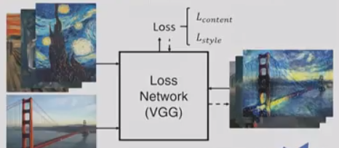
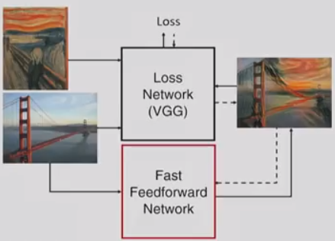
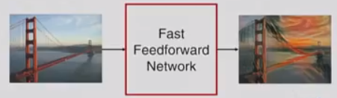
Existing style transfer networks
Slow and Arbitrary style transfer:
Uses a VGG network to extract
content loss
style loss
Iterative optimization to find an output image that reduces simultaneously reduce them.
Able to transfer arbitrarily given styles
Slow! -> Impossible to apply it in real time
Fast and Restricted style transfer:
Replaces the slow optimization by a fast feed-forward network
Feed forward network reduces the same loss functions
Once trained, able to perform style transfer with a single forwardpass eficiently
Much faster!
Not flexible! Restricted to the style trained
Notes:
For stylizing with a new style, it is necessary to train this new style

Slide 6
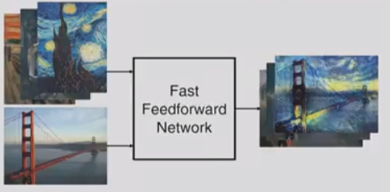
Our style transfer network
Fast and Arbitrary style transfer:
Take as inputs of the feed forward network content and style images
Our network extracts the features from the style images and applies them to the content images
In our case:
Trained several styles at the same time and apply them to content images Arbitrariness tested
Stylization of images rather than real time video from webcam.
No fastness tested
Notes:
Fast for being able to work in real time and flexible enough to transfer arbitrary style.
In our case we have only been able to make it work with images, trainning several styles at the same time (demonstrating flexibility). Even though, this network is also able to work in real time, specifically stylizing video recorded from webcam.
The goal is to take as inputs both the content and style image of the feed forward network instead of only content images as previous works do.

Slide 7
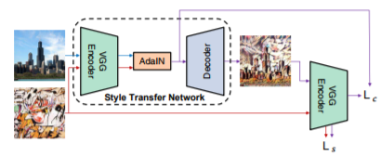
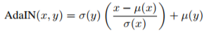
Architecture
Endcoding of content and style images: VGG-19 model layers (up to relu4.1)
An AdaIN layer is used to perform style transfer in the feature space.
A decoder is learned (content and style loss computed) to invert the AdaIN output to the image spaces.
The decoder mostly mirrors the encoder, with all pooling layers replaced by nearest up-sampling to reduce checkerboard effects
Notes:
We use the first few layers (up to relu4.1) of a fixed VGG-19 network to encode the content and style images.
An AdaIN layer is used to align the mean and the variance of the content features to the style features
Feature mean and variance content style information. So, by matching the mean and the variance to the style features, adain can effectively match their styles
A decoder is learned to invert the AdaIN output to the pixel space. We compute content and style loss to train the decoder..
The decoder mostly mirrors the encoder, with all pooling layers replaced by nearest up-sampling to reduce checkerboard effects

Slide 8
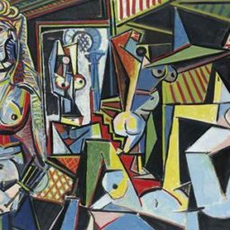

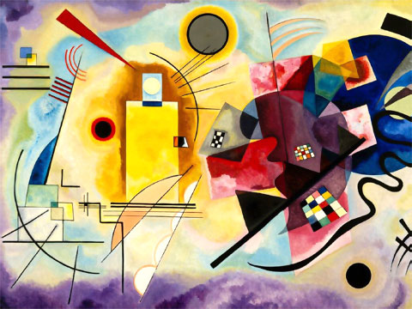
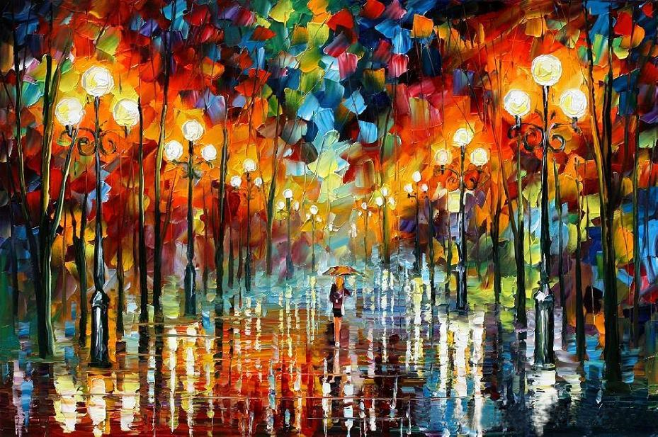
Training phase
Dataset
→ For content images: CIFAR-10
→ For style images:
Notes:
For the trainning we have used the images included in cifar-100 database, which contains 50000 images for trainning.
For style images we download several ones representing the style of famous painters. Here youhave some examples.

Slide 9
Training phase
It takes very long to train.
→ For example, doing 7000 epochs takes 3 hours and 2000, 1 hour.
We decided to use 2000 epochs most of the time.
The first thing that it learns is the colors that the style uses. Then, it learns the particular style of the painting.
More than one style can be trained simultaneously.
Notes:
The decoder mostly mirrors the encoder, with all pooling layers replaced by nearest up-sampling to reduce checkerboard effects

Slide 10
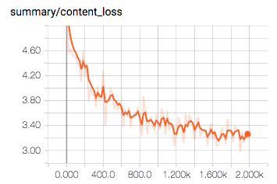
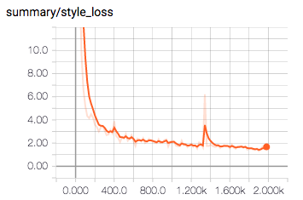
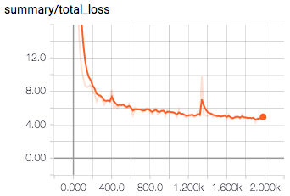
Training phase: Losses (tensorboard)
#Epochs: 2000
Content_weight =1
Style_weight = 1e-2
Notes:
We used tensorboard to charge the logs created when training showing the losses evolution throughout epochs.
For 2000 epochs, content weight 1 and style weight 1e-2 these are the obtained graphics. We can see the loss decreases with epochs

Slide 11
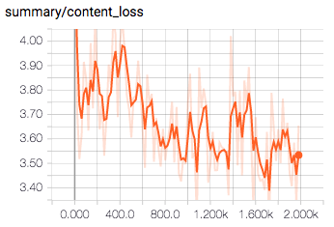
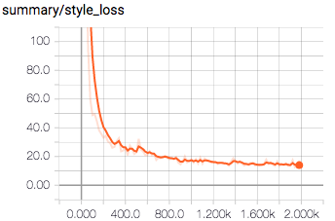
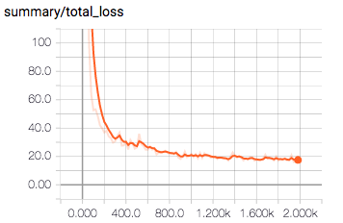
Training phase: Losses (tensorboard)
#Epochs: 2000
Content_weight =0.7
Style_weight = 0.1
Notes:
We can see that when we give less weight to content and more to style the total loss needs more epochs to arrive to the value in the previous case.

Slide 12
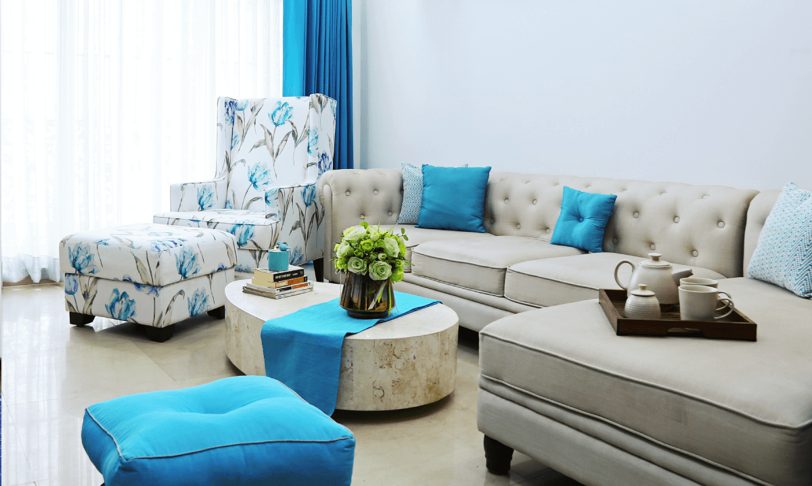


Testing phase
Dataset
→ For content images:
→ For style images: same as for training

Slide 13
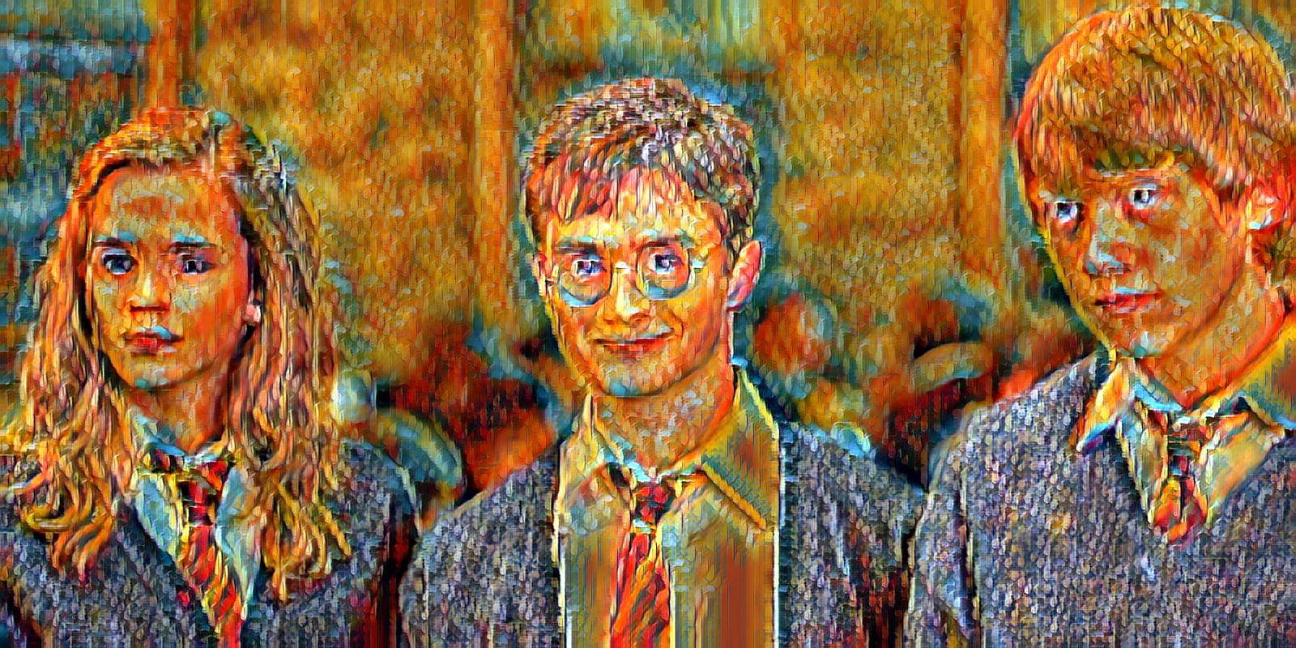


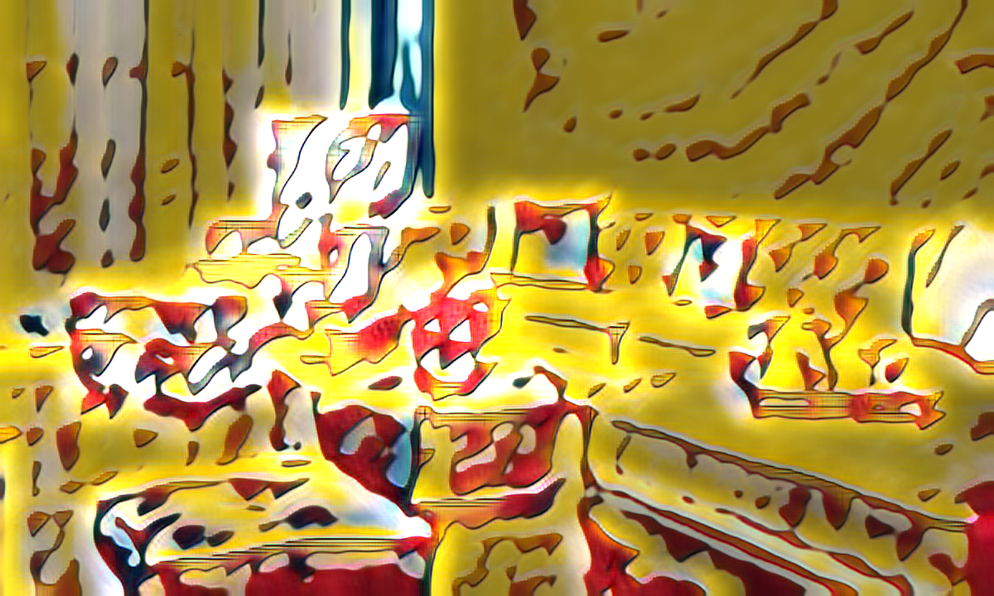
Testing phase
Content
Style
Result

Slide 14
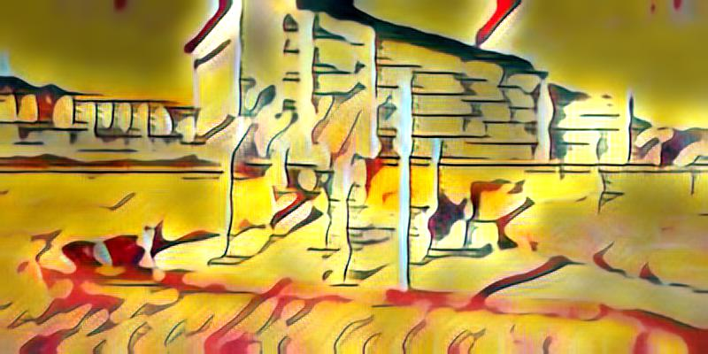
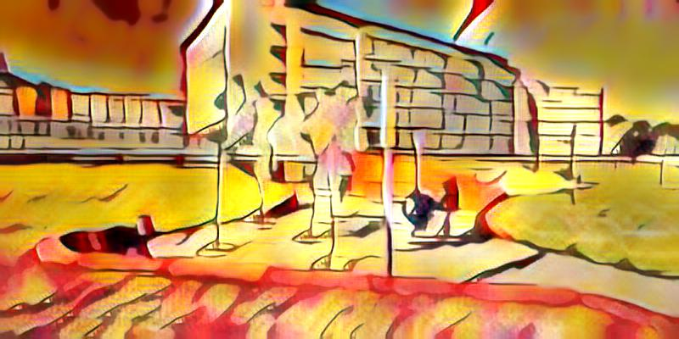
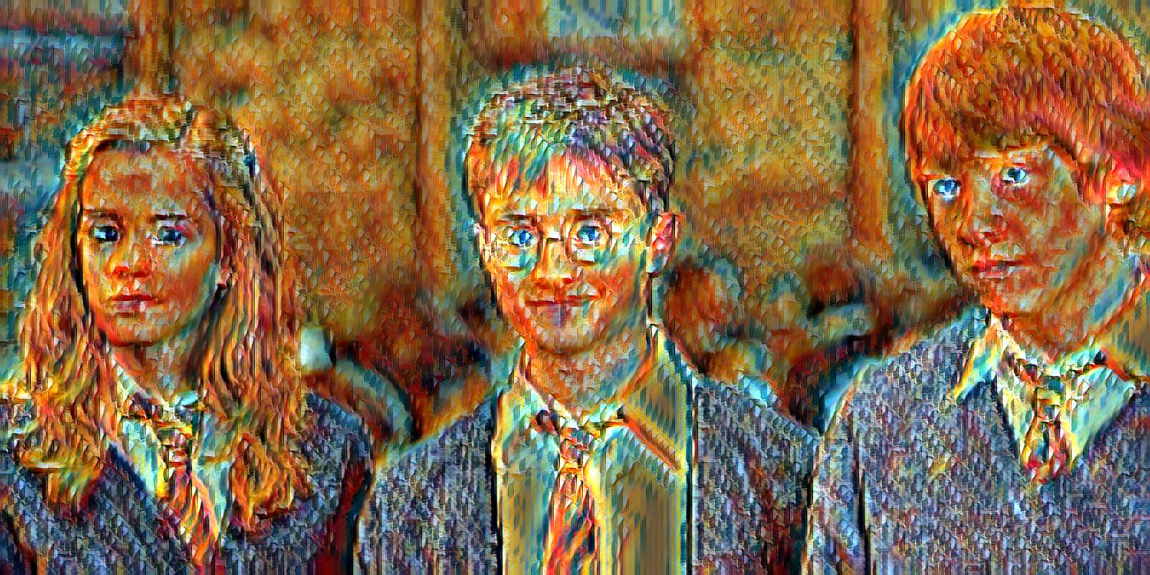
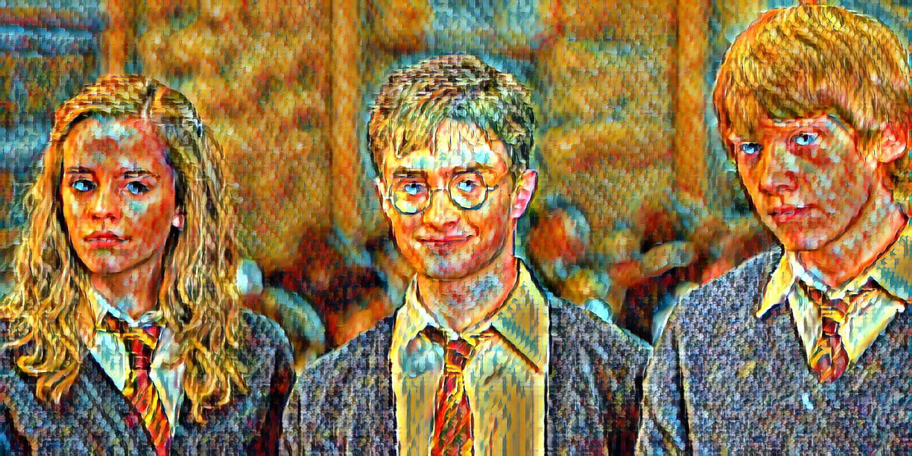
Testing phase: Number of epochs influence
2000
6000
20000

Slide 15
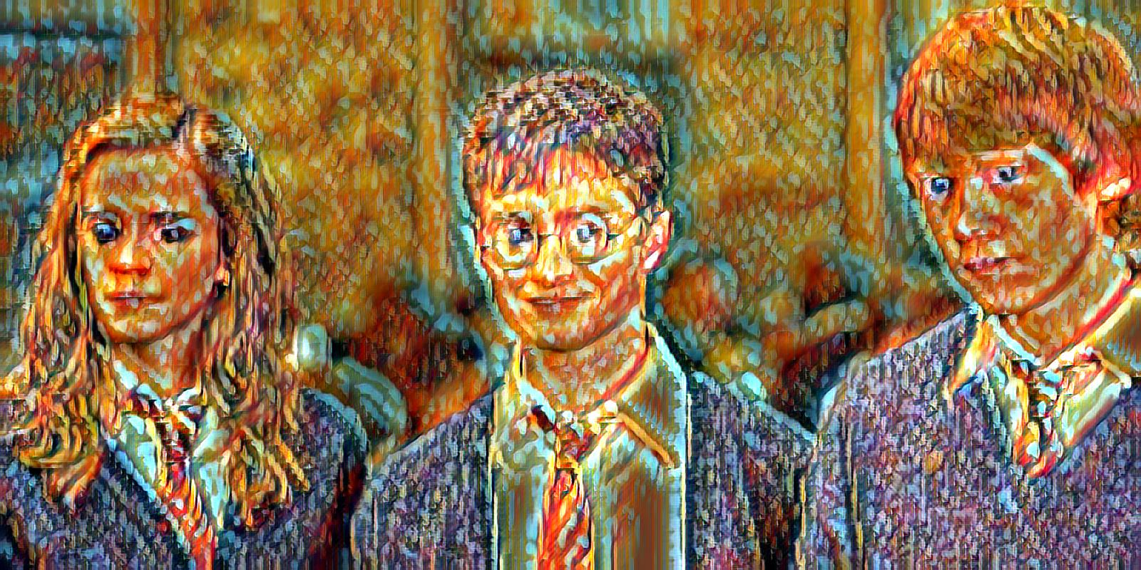
Testing phase: Number of trained images influence
Number of epochs: 2000
Reduced dataset
250 images
Overfitting!
Complete dataset
50000 images

Slide 16
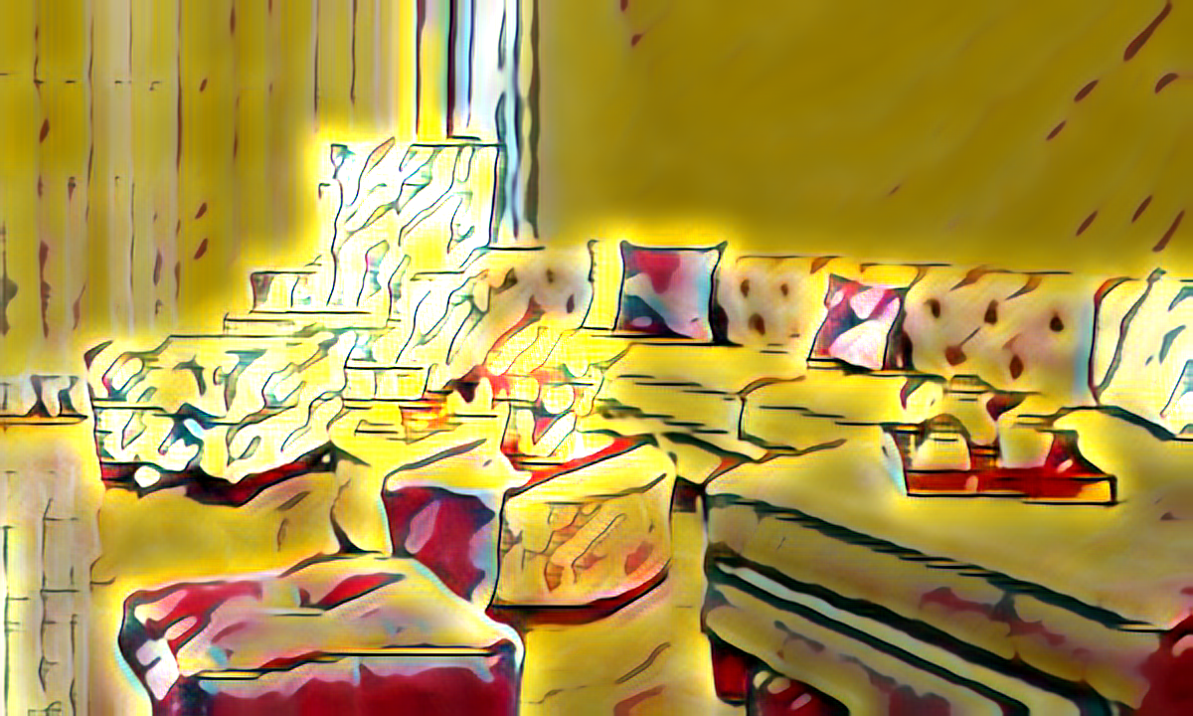
Testing phase: Style weight influence
Style weight: low
Style weight: high

Slide 17
Conclusions
Fast and Arbitrary style transfer
Arbitrariness tested by training and applying several styles at the same time
Fastness not trained since we stylized images rather than webcam video
Testing phase:
Training 2000 epochs -> 1h
Training 7000 epochs -> 3h
Training 20000 epochs -> 10h
Testing phase:
For complete dataset (50000 images)
Until 7000 epochs it still improves
In 20000 epochs there is already overfitting
For reduced training dataset (250 images)
For 2000 epochs there is already overfitting

Slide 18
References
Arbitrary Style Transfer in Real-time with Adaptive Instance Normalization
Xun Huang Serge Belongie
http://openaccess.thecvf.com/content_ICCV_2017/papers/Huang_Arbitrary_Style_Transfer_ICCV_2017_paper.pdf
A Neural Algorithm of Artistic Style.
Leon A. Gatys, Alexander S. Ecker, Matthias Bethge.
http://arxiv.org/abs/1508.06576
https://github.com/eridgd/AdaIN-TF

